Slide 1
Disease Detection From Lung Images
Disease Detection Using Chest X-Rays

Slide 2
Introduction
Lung diseases are among the most prevalent medical conditions worldwide, with a significant impact on healthcare systems and patient quality of life. The early detection and accurate diagnosis of lung pathologies through imaging are crucial for timely treatment and improved outcomes. In this project we use advanced image processing and machine learning techniques to automatically identify disease within lung images.
The crux of our project lies in the meticulous analysis of lung X-ray images, which are a cornerstone for the preliminary screening and diagnosis of pulmonary conditions. X-rays are a non-invasive, widely accessible, and cost-effective imaging tool that captures the complex structures within the thoracic cavity.

Slide 3
Objective
In this project, we look closely at chest X-rays to find out if someone has COVID-19, another lung illness that looks like COVID-19 on X-rays, or healthy lungs. Since COVID-19, the flu, and RSV can all appear similar in lung images, we've developed a tool that can tell them apart. This is especially important because it helps doctors quickly figure out if a patient has COVID-19, another respiratory illness, or no illness at all. Our goal is to make a tool that is good at spotting COVID-19, which can help doctors act fast and give the right care.

Slide 4

Data Source
The database is a collection of chest X-ray images, consisting of several categories: images of patients positive for COVID-19, images depicting normal lung condition, and images of lungs with viral pneumonia. Upon last update, the collection was enriched with a total of 3,616 COVID-19 positive cases, alongside 10,192 normal cases, 6,012 cases of Lung Opacity representing non-COVID lung infections, and 1,345 cases of Viral Pneumonia.
NORMAL
10192
COVID
3616
21165
NONCOVID(FLU & RSV)
3616
Data Source Link: https://drive.google.com/file/d/1bum9Sehb3AzUMHLhBMuowPKyr_PCrB3a/view

Slide 5
Data Preprocessing
Step-1:
Renaming images (COVID_845 to COVID()) same with COVID, Non Covid, Normal.
Step -2
Splitting the datasets into Train, Test and Validation Datasets for 3 Things(COVID, NON Covid, Normal).
Contrast Limited Adaptive Histogram Equalization:
It is an advanced computer vision algorithm used to improve the contrast in images. Unlike standard histogram equalization that applies a global contrast enhancement, CLAHE operates on small regions in the image, called tiles, rather than the entire image. This local approach allows for enhancing the contrast of each tile, so when the tiles are stitched back together, the result is a more uniformly contrasted image and prevents over enhancing noise in the image.

Slide 6
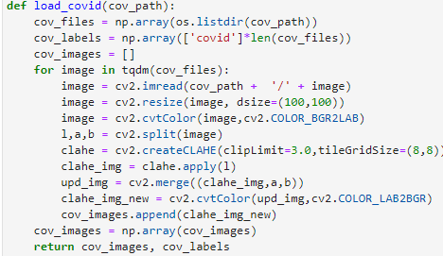
Contd..
I have defined function for Preprocessing which as a results create an array with columns image info and labels
Function Overview:
Purpose: To load and preprocess chest X-ray images for further analysis.
Input: File: path of Dataset
Output: Array of processed images and their corresponding labels.
Processing Steps:
Read Images: Load each image from the directory.
Resize: Adjust the dimensions of each image to 100x100 pixels.
Color Space Conversion: Convert the image from BGR to LAB color space.
Contrast Enhancement: Apply CLAHE to the L channel for better contrast.
Merge Channels: Combine the enhanced L channel with the original A and B channels.
Final Conversion: Convert the image back to BGR color space.
Label Extraction: Extract labels from the filenames.

Slide 7
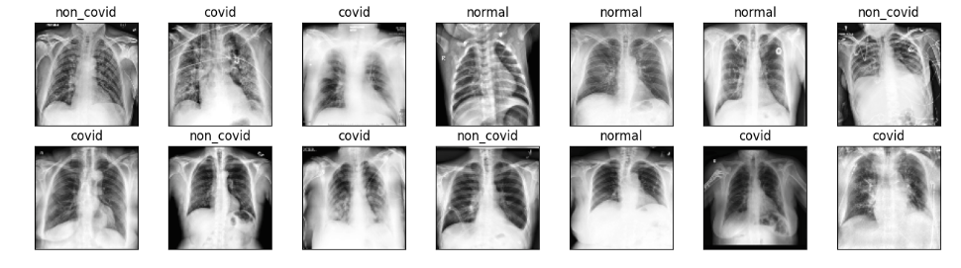
Before we further proceed to the train and test sets This Is what the output of the Function looks like

Slide 8
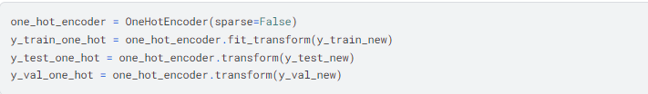
Train, Test and Val sets
So for my model I have reduced the size of the dataset As its taking lot of time to process the initial dataset has 21165 images(including Covid,NonCovid,Normal)
For model:
Train Set=3728 / Test Set= 1116 / Val Set = 730
The onehotencoder() is a preprocessing class from Scikit learning that is often used to convert categorical data, often stored as integers, into a form that can be provided to machine learning algorithms for better predictions.

Slide 9
ML Models used
For ML model I have used ResNet-50 and VGG-16
Here are the common Hyper parameter and Setting that I have used for my pretrained model
Batch_size=64
Epoch=100
Size=100
n_ch=3
ResNet-50
The ResNet50 model is a variant of the ResNet architecture which stands out due to its depth, comprising 50 layers. It utilizes residual connections, or "skip connections," to enable the training of deeper neural networks by allowing gradients to flow through the network more effectively. Pre-trained on the ImageNet dataset, ResNet50 can classify images into 1000 object categories and is widely used as a feature extractor for various image-related tasks.

Slide 10
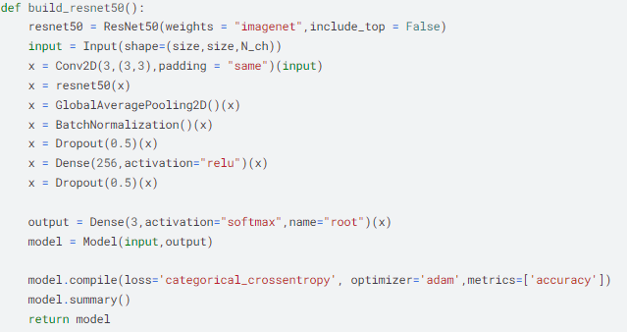
Contd..
Key Points
Pooling and Normalization:
Implement global average pooling
And batch normalization to condense
Features and Regularize the network.
Dropout: Apply Dropout to prevent
overfitting.
Fully Connected Layers: Introduce
Dense layers with ReLU activation for
complex pattern learning.(256 N)
Compilation: Compile the model with
categorical cross entropy loss and
Adam optimizer for training.

Slide 11
Contd..
VGG16:
The VGG16 model is a deep convolutional neural network with 16 layers Developed by the Visual Graphics Group at Oxford, it utilizes repeated blocks of convolutional layers with small filters followed by max pooling, which makes it excellent for capturing fine-grained details and it has a large number of weight parameters, leading to significant memory and computational demands during training

Slide 12
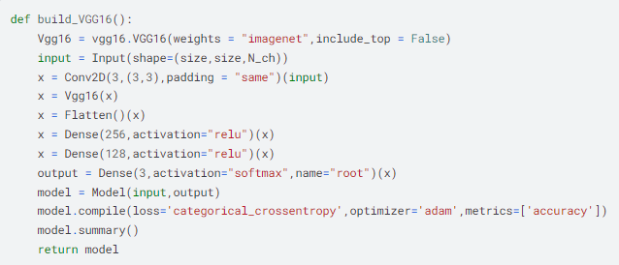
Contd..
Key Points
Adaptation: A convolutional layer to fit input dimensions.
Flattening: Convert feature maps into a 1D array for Dense layers.
Fully Connected Layers: Add Dense layers with 256 and 128 neurons, using ReLU activation for complex patterns.
Output Layer: Employ a softmax activation for multi-class classification with 3 output classes.
Compilation: The model uses categorical cross-entropy loss, Adam optimizer, and tracks accuracy.

Slide 13
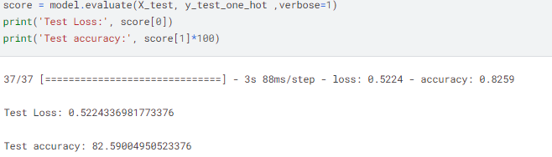
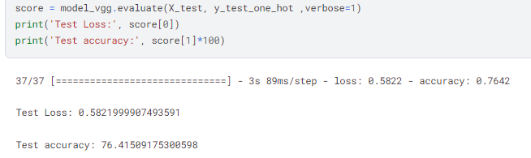
Model Metrics
The Resnet50 achieved a Test accuracy of 82.5%
While VGG16 achieved 76.4% on Test set

Slide 14
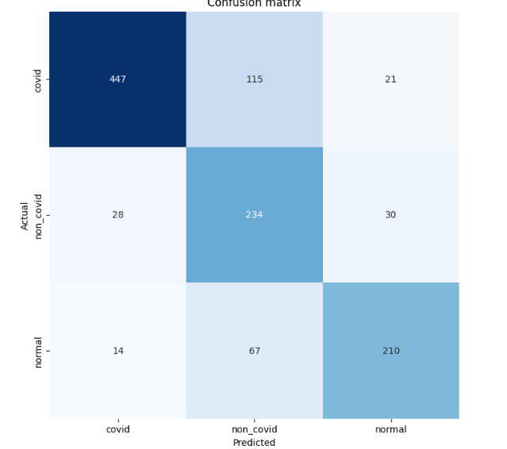
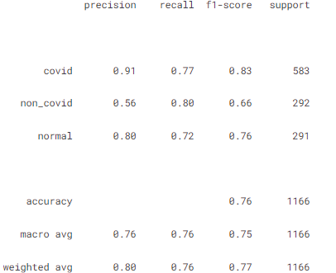
Output VGG16
Confusion matrix
Classification Report

Slide 15
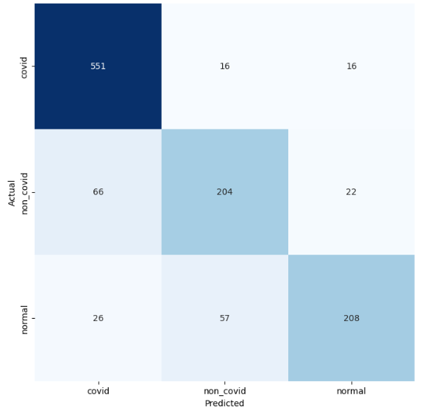
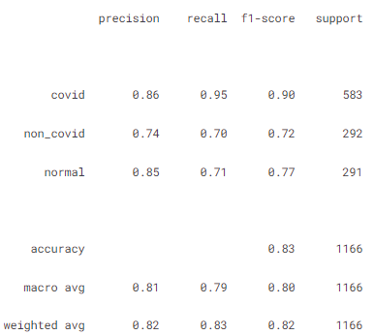
Output ResNet50
Confusion matrix
Classification Report

Slide 16
Thank You

